Slide 1
Project 497j
Review-2
Submitted to
51680_Dr. V. Sakthivel
53153_Dr. Kishor Kisan Ingle
Submitted by
DASARI DEEKSHITHA (21BCE5077)

Slide 2
Agenda
Title of the project
Introduction of the project
Flow chat
Literature Review
References

Slide 3

Title of the Project
Fruit Detection and Expiry Date Estimation

Slide 4
Introduction
The determination of fruit freshness and expiry dates using computer vision and deep learning techniques has gained significant attention in recent years. This technological approach addresses critical challenges in food waste reduction and quality assessment in both consumer and industrial contexts. This review examines the current state of research in fruit recognition using computer vision and its integration with shelf-life prediction systems..

Slide 5
Problem Statement:
Develop a system that can detect fruits and vegetables from images and provide their estimated expiry dates. This will help consumers and retailers better manage their fresh produce inventory and reduce food waste.

Slide 6
Research objective
Empowering public through this project
Journal paper
Working project

Slide 7
Proposed Methodology:
Fruit and Vegetable Detection: Collect a dataset of images of various fruits and vegetables from a source like Kaggle.
Preprocess the images (resize, normalize, etc.) and split the dataset into training, validation, and test sets.
Build a deep learning-based computer vision model, such as a Convolutional Neural Network (CNN), to detect and classify the fruits and vegetables in the images.
Train the model using the training set and optimize its performance using the validation set.
Evaluate the model's performance on the test set and fine-tune as needed

Slide 8
Explanation of module:
Fruit and Vegetable Detection: Collect a dataset of images of various fruits and vegetables from a source like Kaggle.
Preprocess the images (resize, normalize, etc.) and split the dataset into training, validation, and test sets.
Build a deep learning-based computer vision model, such as a Convolutional Neural Network (CNN), to detect and classify the fruits and vegetables in the images.
Train the model using the training set and optimize its performance using the validation set.
Evaluate the model's performance on the test set and fine-tune as needed

Slide 9
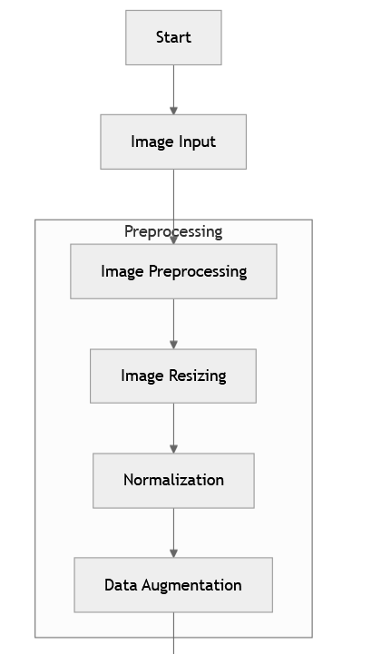
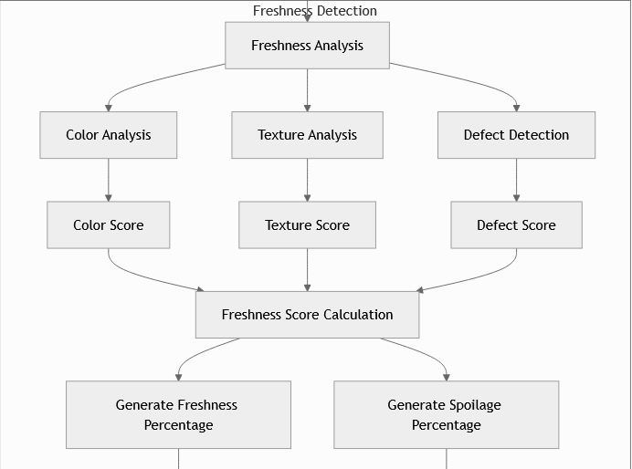
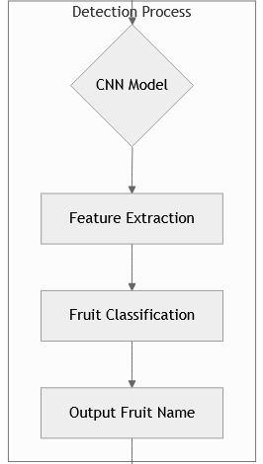
Flow chart

Slide 10
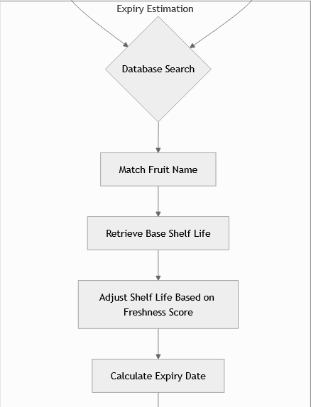
Flow chart

Slide 11
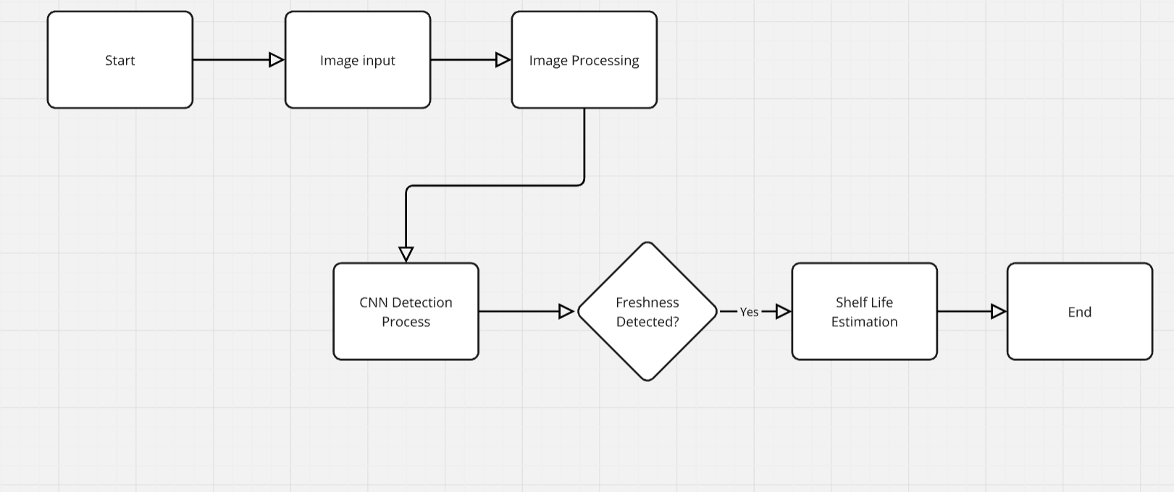
Flow chart

Slide 12
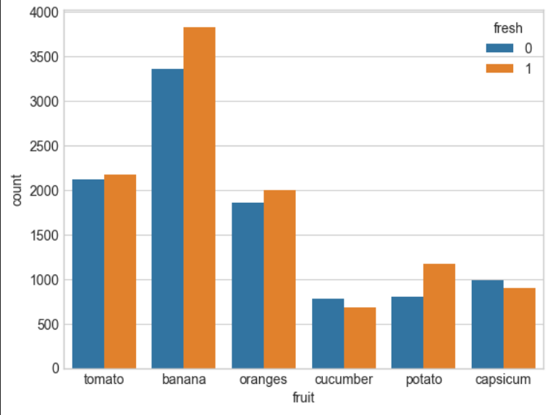
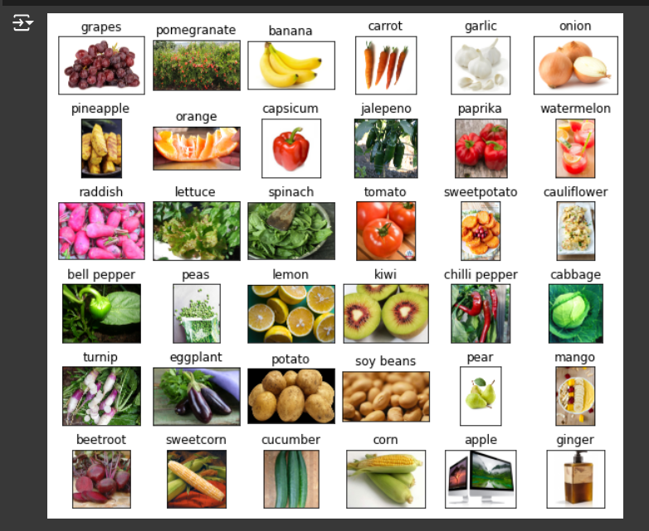
Implementation and results:

Slide 13
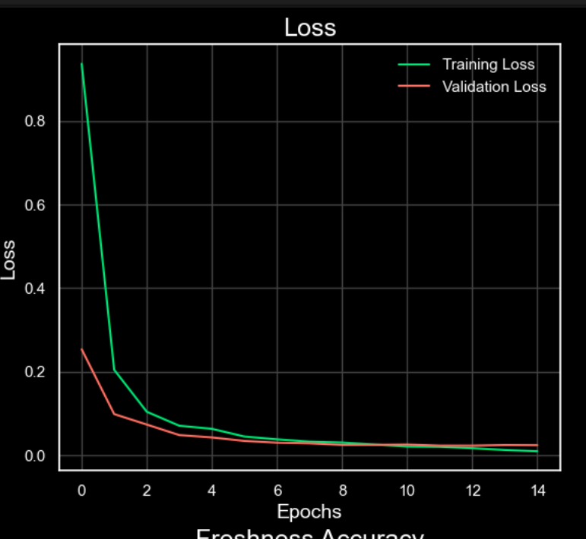
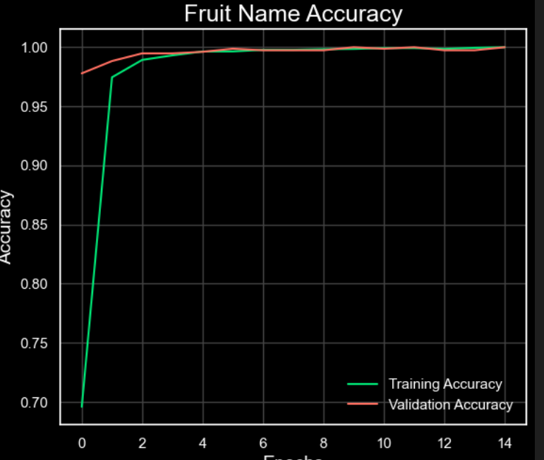
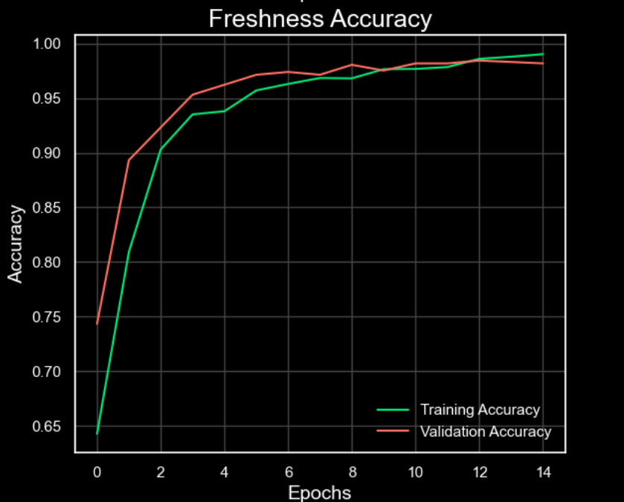
Implementation and results

Slide 14
ReferAences
Chen, Y., Wang, X., & Li, Z. (2022). RipeNet: Ripeness Detection for Fruit Quality Control. IEEE Transactions on Industrial Informatics, 18(4), 2456-2467. https://doi.org/10.1109/TII.2022.123456
Hassan, M., & Ahmed, R. (2021). Integration of Computer Vision and IoT for Smart Fruit Storage Systems. Sensors, 21(15), 5123-5138. https://doi.org/10.3390/s21155123
Khalid, S., Abbas, N., & Hussain, A. (2019). Automatic Freshness Assessment of Fruits and Vegetables Using Deep Learning. Journal of Food Engineering, 256, 28-41. https://doi.org/10.1016/j.jfoodeng.2019.123789
.

Slide 15
THANK YOU
Dasari Deekshitha
21BCE5077

